Slide 1


The Angular 2
Compiler
Lessons learned
Tobias Bosch
@tbosch1009

Slide 2
The Angular 2 Compiler
This talk is about...
... How Angular 2 works internally.
... Our journey to get there.

Slide 3
The Angular 2 Compiler
Inputs
Compile
Running App

Slide 4
Agenda
Performance
x3
Inputs
Parse
Instantiate
Demo

Slide 5
Performance
Performance
x3
Inputs
Parse
Instantiate
Demo

Slide 6
Performance - What is fast?
Page Load
Switching a Route
Update Values

Slide 7
Performance - What is fast?
Page Load
Switching a Route
Update Values

Slide 8
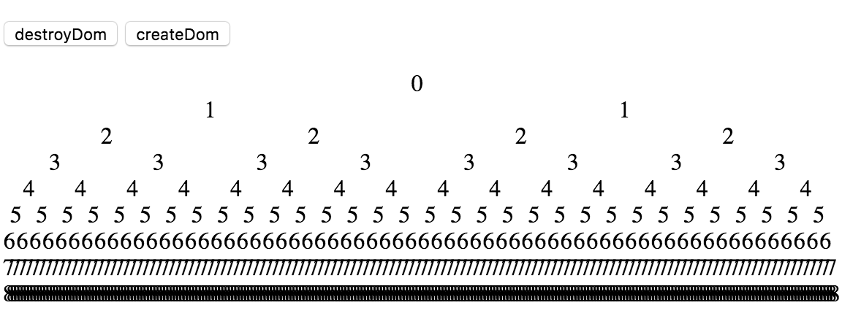
Performance - Deep Tree Benchmark Application

Slide 9
Inputs
Performance
x3
Inputs
Parse
Instantiate
Demo

Slide 10
Inputs - Component Metadata
@Component({
templateUrl: 'hello_comp.html'
})
class HelloComp {
user = { name: 'Tobias' };
}

Slide 11
Inputs - Component Templates
<form>
<div>Hello {{user.name}}</div>
<input ngModel>
</form>
Component
@Component({ ... })
class HelloComp {
user = { name: 'Tobias' };
}

Slide 12
Inputs - Component Templates
<form>
<div>Hello {{user.name}}</div>
<input ngModel>
</form>
Component
@Component({ ... })
class HelloComp {
user = { name: 'Tobias' };
}

Slide 13
Inputs - Directive Metadata
@Directive({ selector: 'form' })
class NgForm {...}
@Directive({ selector: '[ngModel]' })
class NgModel { ... }
Template
<form>
<div>Hello {{user.name}}</div>
<input ngModel>
</form>

Slide 14
Inputs - Directive Dependencies
@Directive({ selector: 'form' })
class NgForm {...}
@Directive({ selector: '[ngModel]' })
class NgModel {
...
constructor(form: NgForm) {...}
}
Template
<form>
<div>Hello {{user.name}}</div>
<input ngModel>
</form>

Slide 15
Inputs - There are more...
@NgModule, @Pipe
@Input, @Output, @ContentChildren, @ViewChildren, @HostBinding, @HostListener
<template>
...

Slide 16
Template Parser
Performance
x3
Inputs
Parse
Instantiate
Demo

Slide 17
Template Parser - HTML
{ name: 'form', children: [
{ name: 'div', children: [
{ text: 'Hello ' },
{ text: '' },
]},
{ name: 'input',
attrs: [['ngModel', '']]
}
]}
Template
<form>
<div>Hello {{user.name}}</div>
<input ngModel>
</form>

Slide 18
Template Parser - Expressions
...
{ text: '',
expr: {
propPath: ['user', 'name'] },
line: 2, col: 14
}
}
Template
<form>
<div>Hello {{user.name}}</div>
<input ngModel>
</form>

Slide 19
Template Parser - Line/Column Numbers
Uncaught EXCEPTION: Error in hello_comp.html:2:14
Uncaught TypeError: Cannot read property 'name'
of undefined...
Template
<form>
<div>Hello {{user.name}}</div>
<input ngModel>
</form>
AST
{ text: '',
expr: {
propPath: ['user', 'name'] },
line: 2, col: 14
}
}

Slide 20
Template Parser - Directives
{ name: 'input', attrs: [['ngModel', '']],
directives: [{
ctor: NgModel,
deps: [NgForm],
}]
}
Template
<form>
<div>Hello {{user.name}}</div>
<input ngModel required>
</form>
Directive
@Directive({
selector: '[ngModel]' })
class NgModel {
...
constructor(form: NgForm) {...}
}

Slide 21
Template
Instantiation 101
Performance
1/3
Inputs
Parse
Instantiate
A Simple Approach
Demo

Slide 22
Instantiation 101
Fastest way to create a DOM element?
☑element.innerHTML = '<form>...'
☑var clone = element.cloneNode(true)
☑document.createElement(...)

Slide 23
Instantiation 101 - element.innerHTML
var compEl = ...;
compEl.innerHTML = '<form>...';
var userNameText = compEl.childNodes[0]
.childNodes[0].childNodes[0];
Template
<form>
<div>Hello {{user.name}}</div>
<input ngModel>
</form>

Slide 24
Instantiation 101 - document.createXYZ
var divEl = document.createElement('div');
divEl.appendChild(document.createTextNode('Hello'));
var userNameText = document.createTextNode();
divEl.appendChild(userNameText);
...
Template
<form>
<div>Hello {{user.name}}</div>
<input ngModel>
</form>

Slide 25
Instantiation 101 - Create Elements
class NgElement {
parent: NgElement;
domEl: HTMLElement;
directives: Map; // type -> instance
}
NgElement
NgElement
NgElement

Slide 26
Instantiation 101 - Create Elements
class NgElement {
parent: NgElement;
domEl: HTMLElement;
directives: Map; // type -> instance
constructor(parent: NgElement, ast: ElementAst) {
this.domEl = document.createElement(ast.name);
ast.attrs.forEach( (attr) =>
this.domEl.setAttribute(attr[0], attr[1]));
parent.domEl.appendChild(this.domEl);
// ... create the directives
}
}
Template
<form>
<div>Hello {{user.name}}</div>
<input ngModel>
</form>
Element AST
{ name: 'input', directives: ...,
attrs: [['ngModel', '']]
}

Slide 27
Instantiation 101 - Create Directives
class NgElement {
parent: NgElement;
domEl: HTMLElement;
directives: Map; // type -> instance
createDirective(dirAst) {
var deps = ast.deps.map( (depType) =>
this.getDirectiveDep(depType);
this.directives.set(ast.ctor,
new ast.ctor(...deps));
}
}
Template
<form>
<div>Hello {{user.name}}</div>
<input ngModel>
</form>
Element AST
{ name: 'input', directives: [
{ ctor: NgModel,
deps: [NgForm] }
], attrs: ...}

Slide 28
Instantiation 101 - Resolve Dependencies
class NgElement {
parent: NgElement;
domEl: HTMLElement;
directives: Map; // type -> instance
getDirectiveDep(dirType) {
if (this.directives.has(dirType)) {
return this.directives.get(dirType);
}
return this.parent.getDirectiveDep(dirType);
}
}
Template
<form>
<div>Hello {{user.name}}</div>
<input ngModel>
</form>
Element AST
{ name: 'input', directives: [
{ ctor: NgModel,
deps: [NgForm] }
], attrs: ...}

Slide 29
Instantiation 101 - Data Binding
class Binding {
target: Node;
targetProp: string;
expr: BindingAST;
lastValue: any;
}
target = #text
targetProp = 'nodeValue'
Template
<form>
<div>Hello {{user.name}}</div>
<input ngModel>
</form>
Text AST
{ text: '',
expr: { propPath:
['user', 'name']
line: 2, col: 14 }
} }

Slide 30
Instantiation 101 - Data Binding
class Binding {
target: Node;
targetProp: string;
expr: BindingAST;
lastValue: any;
check(component: any) {
var newValue = evaluate(this.expr, component);
if (newValue !== this.lastValue) {
this.target[this.targetProp] =
this.lastValue = newValue;
}
}
}
Template
<form>
<div>Hello {{user.name}}</div>
<input ngModel>
</form>
Text AST
{ text: '',
expr: { propPath:
['user', 'name']
line: 2, col: 14 }
} }

Slide 31
Instantiation 101 - Data Binding Error Handling
class Binding {
check(component: any) {
try {
...
} catch (e) {
throw new Error(`Error in ${this.expr.line}:`+
`${this.expr.col}: ${e.message}`);
}
}
}
Template
<form>
<div>Hello {{user.name}}</div>
<input ngModel>
</form>
Text AST
{ text: '',
expr: { propPath:
['user', 'name']
line: 2, col: 14 }
} }

Slide 32
Instantiation 101 - View
class View {
component: any;
ngElements: NgElement[];
bindings: Binding[];
dirtyCheck() {
this.bindings.forEach( (binding) => binding.check(this.component) );
}
}

Slide 33
Instantiation 101 - Performance
Deep Tree benchmark:
About the same as Ng 1

Slide 34
Template Instantiation 201
Performance
2/3
Inputs
Parse
Instantiate
Optimize data structures
Demo

Slide 35
Instantiation 201 - Previous NgElement
class NgElement {
parent: NgElement;
domEl: HTMLElement;
directives: Map; // type -> instance
getDirectiveDep(dirType) {
if (this.directives.has(dirType)) {
return this.directives.get(dirType);
}
return this.parent.getDirectiveDep(dirType);
}
}

Slide 36
Instantiation 2 - Optimized Data Structures
class InlineNgElement {
...
dir0, dir1, ...: any;
dirType0, dirType1, ...: any;
getDirectiveDep(dirType) {
if (type === this.dirType0) return this.dir0;
if (type === this.dirType1) return this.dir1;
...
}
}
Fast Property Access via Hidden Classes!

Slide 37
Instantiation 201 - View Cache
var cache: View[];
class View {
ngElements: NgElement[];
bindings: Binding[];
dehydrate() {
// keep the DOM node!
// clear directive instances
// clear last binding values
}
hydrate() {
// create directive instances again
}
}
Reuse Data Structures!

Slide 38
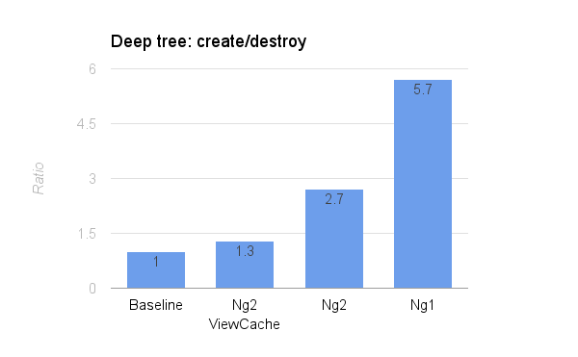
Instantiation 201 - Performance

Slide 39
Template Instantiation 301
Performance
3/3
Inputs
Parse
Instantiate
Generate view classes
Demo

Slide 40
Instantiation 301 - Previous View Class
class View {
component: any;
ngElements: InlineNgElement[];
bindings: Binding[];
}
class InlineNgElement {
dir0, dir1, ...: any;
dirType0, dirType1, ...: any;
...
}

Slide 41
Instantiation 301 - Create Elements
function HelloCompView(component) {
this.component = component;
this.node0 = document.createElement('form');
this.node1 = document.createElement('div');
this.node0.appendChild(this.node1);
...
}
Template
<form>
<div>Hello {{user.name}}</div>
<input ngModel>
</form>

Slide 42
Instantiation 301 - Create Directives
function HelloCompView(component) {
...
this.dir0 = new NgForm();
...
this.dir1 = new NgModel(this.dir0);
}
Template
<form>
<div>Hello {{user.name}}</div>
<input ngModel>
</form>

Slide 43
Instantiation 301 - Data Binding
HelloCompView.prototype.dirtyCheck = function() {
var v = this.component.user.name;
if (v !== this.exprVal0) {
this.node3.ngModel = v;
this.exprVal0 = v;
}
}
Template
<form>
<div>Hello {{user.name}}</div>
<input [(ngModel)]="user.name">
</form>

Slide 44
Instantiation 301 - Generated View Classes
class HelloCompView {
node0, node1, node2, ... : Node;
dir0, dir1, dir2, ...: any;
exprVal0, exprVal1, exprVal2, ...: any;
}
Fast Property Access everywhere!

Slide 45
Instantiation 301 - How to generate the View Classes?
Instantiation 101
Instantiation 301
Directives / DOM nodes: Create / call them
Generate code that will create / call them
Directive / DOM node references
Property names on View class

Slide 46
Instantiation 301 - How to generate the View Classes?
class NgElement {
domEl: HTMLElement;
constructor(parent: NgElement, ast: ElementAst) {
this.domEl =
document.createElement(ast.name);
parent.domEl.appendChild(
this.domEl);
// ...
}
}
class CompileElement {
domElProp: string = newPropertyVar();
stmts: string[];
constructor(parent: CompileElement, ast: ElementAst) {
this.stmts = [`
this.${domElProp} =
document.createElement('${ast.name}');
this.${parent.domElProp}.appendChild(
${this.domElProp});
`]; // ...
}
}

Slide 47
Instantiation 301 - How to generate the View Classes?
class NgElement {
domEl: HTMLElement;
constructor(parent: NgElement, ast: ElementAst) {
this.domEl =
document.createElement(ast.name);
parent.domEl.appendChild(
this.domEl);
// ...
}
}
class CompileElement {
domElProp: string = newPropertyVar();
stmts: string[];
constructor(parent: CompileElement, ast: ElementAst) {
this.stmts = [`
this.${domElProp} =
document.createElement('${ast.name}');
this.${parent.domElProp}.appendChild(
${this.domElProp});
`]; // ...
}
}

Slide 48
Instantiation 301 - How to generate the View Classes?
class NgElement {
domEl: HTMLElement;
constructor(parent: NgElement, ast: ElementAst) {
this.domEl =
document.createElement(ast.name);
parent.domEl.appendChild(
this.domEl);
// ...
}
}
class CompileElement {
domElProp: string = newPropertyVar();
stmts: string[];
constructor(parent: CompileElement, ast: ElementAst) {
this.stmts = [`
this.${domElProp} =
document.createElement('${ast.name}');
this.${parent.domElProp}.appendChild(
${this.domElProp});
`]; // ...
}
}

Slide 49
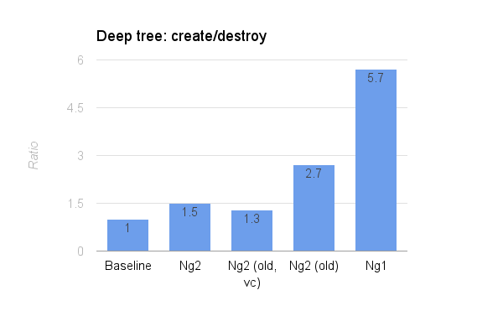
Instantiation 301 - Performance

Slide 50
JIT Compilation
Performance
x3
Inputs
Parse
Instantiate
Demo

Slide 51
JIT Compilation - Overview
Server
Browser
Inputs
Parse & Generate
View Source
Eval
View Class
new ...()
Running App

Slide 52
JIT Compilation - Overview
Server
Browser
Inputs
Parse & Generate
View Source
Eval
View Class
new ...()
Running App

Slide 53
JIT Compilation - Overview
Server
Browser
Inputs
Parse & Generate
View Source
Eval
View Class
new ...()
Running App

Slide 54
JIT Compilation - Enhanced Minification
Server unminified
Browser
Component
@Component({ ... })
class HelloComp {
user = { name: 'Tobias' };
}
Component
Template
<div>Hello {{user.name}}</div>
Template
Generate
View Class
var v = this.comp.user.name;

Slide 55
JIT Compilation - Enhanced Minification
Server minified
Browser
Component
@Component({ ... })
class C1 {
u = { n: 'Tobias' };
}
Component
Template
<div>Hello {{user.name}}</div>
Template
Generate
View Class
var v = this.comp.user.name;

Slide 56
AOT Compilation
Performance
x3
Inputs
Parse
Instantiate
Demo

Slide 57
JIT Compilation - Overview
Server
Browser
Inputs
Parse & Generate
View Source
<script>
View Class
new ...()
Running App

Slide 58
JIT Compilation - Overview
Server
Browser
Inputs
Parse & Generate
View Source
<script>
View Class
new ...()
Running App

Slide 59
JIT Compilation - Overview
Server
Browser
Inputs
Parse & Generate
View Source
<script>
View Class
new ...()
Running App

Slide 60
AOT Compilation - Enhanced Minification
Server unminified
Browser
Component
@Component({ ... })
class HelloComp {
user = { name: 'Tobias' };
}
Component
Template
<div>Hello {{user.name}}</div>
Generate
View Class
var v = this.comp.user.name;
ViewClass

Slide 61
AOT Compilation - Enhanced Minification
Server minified
Browser
Component
@Component({ ... })
class C1 {
u = { n: 'Tobias' };
}
Component
Template
<div>Hello {{user.name}}</div>
Generate
View Class
var v = this.comp.u.n;
ViewClass

Slide 62
AOT compilation - TypeScript Output
Serialize
View Source
for Eval (ES5)
Inputs
Parse & Generate
View Source
(Output AST)
View Source
(TypeScript)
View Source
(ES 2016)

Slide 63
AOT Compilation - TypeScript Output
{ kind: 'declareVar', name: 'el',
type: { kind: 'ambient', name: 'HTMLElement' },
value: {
kind: 'invokeMethod',
receiver: { kind: 'readVar', name: 'document' },
name: 'createElement',
params: { kind: 'literal', value: 'div' }
}
}
Generated ES5 code
var el = document
.createElement('div');
Generated TypeScript code
var el: HTMLElement = document
.createElement('div');

Slide 64
AOT Compilation - TypeScript Output
{ kind: 'declareVar', name: 'el',
type: { kind: 'ambient', name: 'HTMLElement' },
value: {
kind: 'invokeMethod',
receiver: { kind: 'readVar', name: 'document' },
name: 'createElement',
params: { kind: 'literal', value: 'div' }
}
}
Generated ES5 code
var el = document
.createElement('div');
Generated TypeScript code
var el: HTMLElement = document
.createElement('div');

Slide 65
AOT Compilation - TypeScript Output
{ kind: 'declareVar', name: 'el',
type: { kind: 'ambient', name: 'HTMLElement' },
value: {
kind: 'invokeMethod',
receiver: { kind: 'readVar', name: 'document' },
name: 'createElement',
params: { kind: 'literal', value: 'div' }
}
}
Generated ES5 code
var el = document
.createElement('div');
Generated TypeScript code
var el: HTMLElement = document
.createElement('div');

Slide 66
AOT Compilation - Metadata Collection
var supportsCookies =
document.cookie;
@Directive({
selector: '[someDir]',
})
class SomeDir {
// use supportsCookies...
}

Slide 67
AOT Compilation - Metadata Collection
var supportsCookies =
document.cookie;
function SomeDir() {
// use supportsCookies...
}
SomeDir.annotations = [{
selector: '[someDir]',
}];

Slide 68
AOT Compilation - Metadata collection
{ "SomeDir": {
"decorators": [{
"expression": { "module": "@angular/core",
"name": "Directive" },
"arguments": [{ "selector": "[someDir]" }]
}]
} }
Source
var supportsCookies =
document.cookie;
@Directive({
selector: '[someDir]',
})
class SomeDir {
// use supportsCookies...
}

Slide 69
AOT Compilation - Metadata collection
{ "SomeDir": {
"decorators": [{
"expression": { "module": "@angular/core",
"name": "Directive" },
"arguments": [{ "selector": "[someDir]" }]
}]
} }
Source
var supportsCookies =
document.cookie;
@Directive({
selector: '[someDir]',
})
class SomeDir {
// use supportsCookies...
}

Slide 70
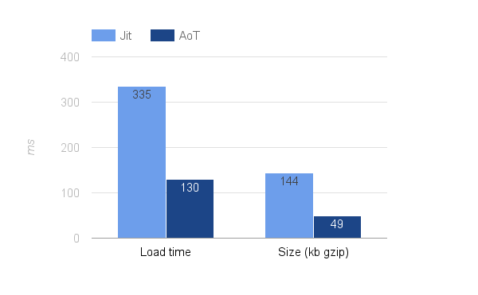
JIT vs AOT Compilation - Page Load Performance

Slide 71
Demo
Performance
x3
Inputs
Parse
Instantiate
$ ngc -p <project>
Demo

Slide 72
What's next
Smaller: 10kb
FTL: Faster Than baseLine

Slide 73

Performance
Performance
document.
createElement()
x3
x3
Fast Property Access / Hidden Classes [1]
Inputs
Inputs
Parse
Parse
Instantiate
Instantiate
Codegen Classes
Just in Time vs Ahead of Time Compile
Demo
Demo
g.co/ng/ac16-compiler
[1] github.com/v8/v8/wiki/Design%20Elements

